Slide 1
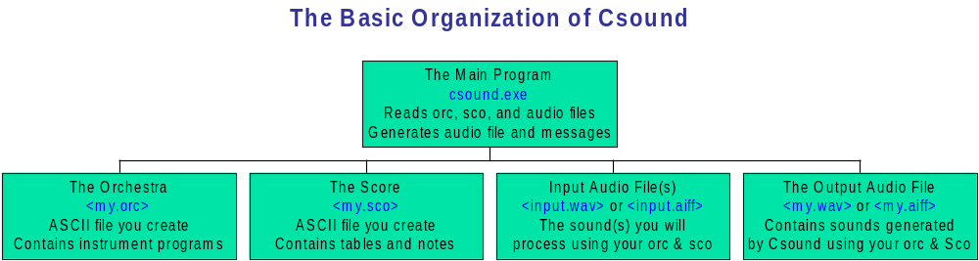
Working with Csound

Slide 2
Installation and Configuration
PC: Download the newest “console” version from www.csounds.com
Create a folder in the root directory for Csound: c:\csound and unzip Csound into it.
Make sure c:\csound is in your PATH
Create another folder for your sounds: c:\sounds
Create SFDIR, SSDIR, and SADIR environment variables that point to the correct folders
Create a folder(s) for your orch and score files

Slide 3
Installing WinXound Pro
There is a useful shell for editing and running Csound programs under Windows called WinXound Pro. Get it here:
  http://www.ibiart.it/winxound/download.asp
Download the full version, unzip the installation file into temporary directory, and then run it and follow instructions.
Launch the program and choose File/Settings to configure the program.

Slide 4
Installation on Macintosh
Download the CsoundMacPPC version from www.csounds.com
Simple user interface shell built in
Select default directories, text and audio editors
Use any text editor or word processor to create your orchestras and scores, but if using a word processor, be sure to save your files in plain text (ascii) format
Select “real time” for testing, “16 bit integer” and Aiff/Aiff-C for output audio files
Don’t use floating point/rescale option for asst’s

Slide 5
Steps in running Csound
Use a text editor to create your orchestra and score files (save them as <name>.orc & <name>.sco)
Run Csound on them
  Parses the orchestra and checks for syntactical errors -> orc.srt
  Parses the score, checks for errors, and sorts -> score.srt
  Performs the notes in the score, generates an output listing, and produces an output audio file (usually .wav or .aiff) on the hard drive
Note any errors in output listing and fix problems
Play the output sound file (.wav or .aiff), using either a media player or an audio editor

Slide 6
Syntax of the Orchestra
The Csound orchestra file is a simple ASCII text file that contains program statements in the Csound language.
All Csound orchestra statements follow the conventional left to right flow from input arguments to an output result:
Statement format:
label: result opcode arg1, arg2,... ;comments

Slide 7
Fields of an Orc Statement
label: | Optional field used to identify a statement as the target of a branching operation (e.g., goto). Alphanumeric text. Ends with a colon (to distinguish it from result variables).
result | Field used by most Csound opcodes to contain the result of the operation. Begins with i, k, or a. Alphanumeric.
operation | Separated from the result and arguments fields by one or more spaces. Must contain a valid Csound opcode.
arguments | A string of constants and variables (defined in a previous statement), separated by commas. Spaces optional.
;comments | An extremely important field! Helps human beings ☺ understand what is supposed to be happening in the code.

Slide 8
Simple Orchestra
result opcode arguments comments
sr = 22050 ;sampling rate is 22050
kr = 2205 ;control rate is 2205
ksmps = 10 ;n samps per control period
nchnls = 1 ;mono orchestra
instr 1 ;begin an instrument block
kamp linen 7500, .1, 1, .5 ;Peak amp gated at k-rate
asig oscil kamp, 440, 1 ;Play function 1 at A-440Hz
out asig ;Mono output
endin ;end this instrument block

Slide 9
Csound Orchestra Variables
Variable Naming Conventions:
The following table demonstrates the use of the mode prefixes a, k, and i, which define how often a variable's value is updated, and the type prefix g, which is used to identify global variables.
Prefix Local Global Description
a aname ganame value updated at Audio Rate
k kname gkname value updated at Control Rate
i iname giname value set at Initialization Time

Slide 10
Special Variables
Certain variable names are reserved for special purposes by CSound. Some of these variables must be set by the user in orchestra header statements, others are set from the score. The score parameter variables (p-variables) should (usually) not be modified from within the orchestra (i.e., used in the result field of a basic statement or CSound expression).
Name Type Description
sr Global Sample Rate
kr Global Control Rate
ksmps Global Samples per Control Period
nchnls Global Number of output channels
p1,p2,...pn Local Score i-card Parameters

Slide 11
Execution Order (multiple passes)
Orchestra Setup | Initial pass over entire orchestra. Flags syntactical errors and sets basic parameters for execution (sets values of special global variables like sr, kr, nchnls, etc.)
Note Initialization | Occurs once, at the beginning of each new note in the score. Calculates and sets the value of all i-type variables and parameters.
Performance | Multiple passes (at the krate) through the code of any instruments currently playing. Computes and sets values for all k-type and a-type variables. In each performance pass, k-type variables are calculated once, while a-type variables are calculated ksmps times.

Slide 12
Basics of the Csound Score
A separate file containing control info
Info on statements, consisting of:
  Op Symbols followed by p-fields
  p-fields separated by one or more blanks
  6 Op Symbols (a,e,f,i,s,t) – p-fields differ
  i and f statements most common
    i <num> <start> <dur> <p4-on>…
    f <num> <start> <size> <gen#> <p5-on>…

Slide 13
Simple Score
Note: the lines in blue show score format and are not part of the actual score statements in this example.
; Generate function number 1 using Gen Subroutine 10:
op num start size gen# p5… (depend on Gen Sub)
f 1 0.0 512 10 1 ;sine wave in 512-locations
; play note on instr 1 starting at time 0 and lasting 1 beat:
op num start dur p4… (depend on instr definition)
i 1 0.0 1.0
e ;optional, if at end of file

Slide 14
Gen Subroutines
Function generation utilities invoked from the score using “f” statements
Used to fill tables containing functions and waveshapes that can then be accessed from the orchestra via the table number
Size of table must be specified as the third field of the f-statement - usually must be a power of 2
Functions stored in larger tables will have greater resolution
  For audio waveshapes, use at least 512
  For control functions, 128 or 256 may be sufficient

Slide 15
Miscellani
All Csound f-tables are real numbers
Automatically rescaled to +1.0/-1.0
  Unless gen number (p4) is negative
During execution, most f-tables will be graphed for you on display/output
F-tables can be replaced in score by re-using same table number later in score
Use Fgenie (PC/Windows app) to test

Slide 16
Guard Points
f-tables always have an extra location at the end called the “guard point”
Used by interpolating units
Guard point is usually automatic and is a copy of first location – appropriate for cyclical functions, like sinusoidal waves
You can specify an “extended” guard point – add one to table size and fill it

Slide 17
Gen10 – for harmonic partials
Gen 10 best for specifying waveshapes that are sums of harmonic partials
Format:
f<no> <st> <size> 10 a1 a2 a3…
  Where a1, a2, a3 are relative amplitudes of successively higher partial numbers
  f 23 0 512 10 100 50 33 25 20
  f 76 0 8192 10 0 0 0 10 20 30 40 50

